Slide 1
Software Proposal Document for project Genetics
Kareem Ehab, Mohamed Moataz, Youssef Assem, Ahmed Gamal

Slide 2
Introduction:
Motivation :
Academic
Business
Problem Statement

Slide 3
Project Description
Objectives
Scope
System Overview

Slide 4
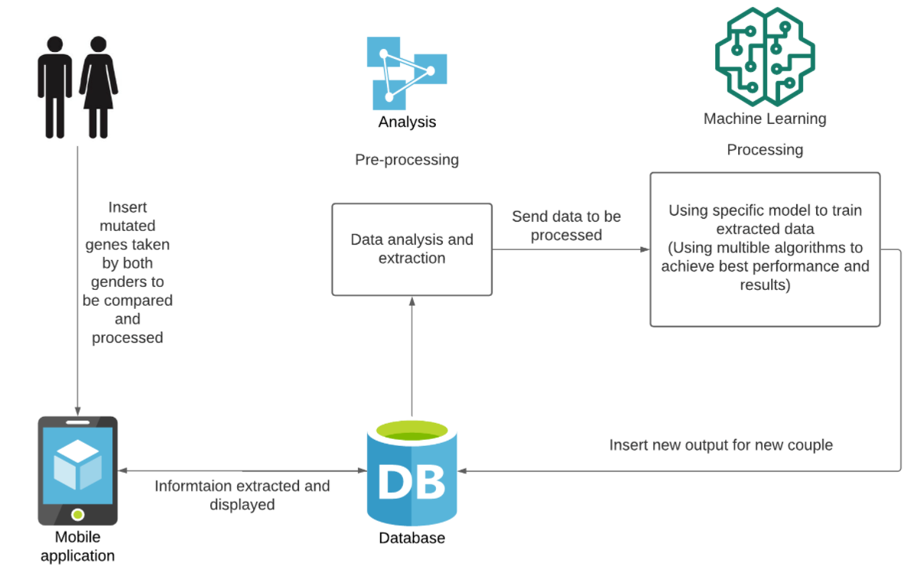
System overview

Slide 5
Deliverables
• The project will provide a model for everyone to help them understand what genetic diseases willaf-fect their children’s future generations
• Describe in brief detail the features of each of the deliverables. Our model uses data from a single or altered gene, which is analyzed by our machine learning system to determine how high a human could be infected
• Project milestones:
1- Collect a useful dataset containing snippets of altered genes OR the entire genome of patients with genetic diseases.
2- Make a mobile app that allows anyone to enter their entire genome or snippets of mutated genes.
3- Create a robust model for predicting genetic illnesses in future generations.
4- Trying out a variety of algorithms to find the best one for building the model on top of.
5- Deploy our software in the marketplace

Slide 6
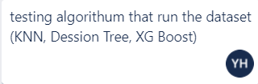
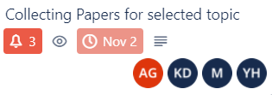




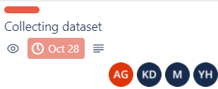
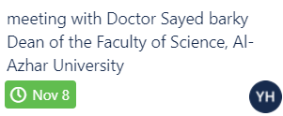

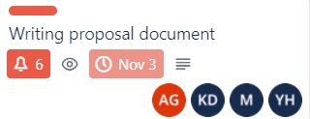
Tasks and Time Plan
Testing
Doing
Done

Slide 7
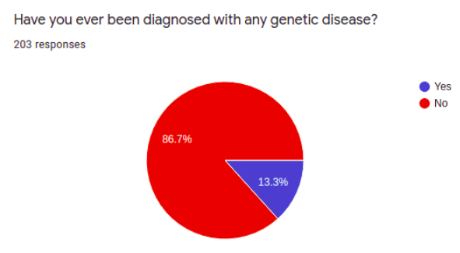
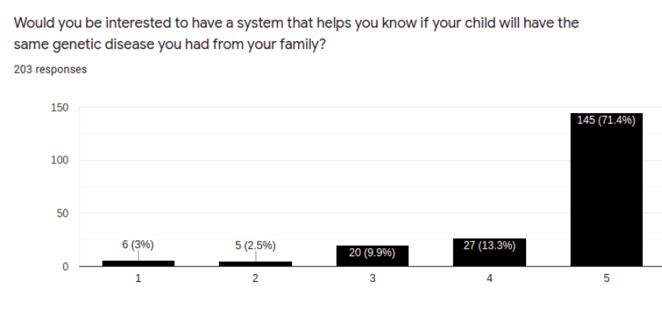
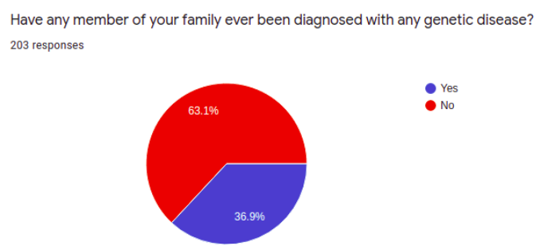
Supportive Documents survey
we collect (203) responses in two days some people from Saudi Arabia, Dubai. Here is our statistics.

Slide 8
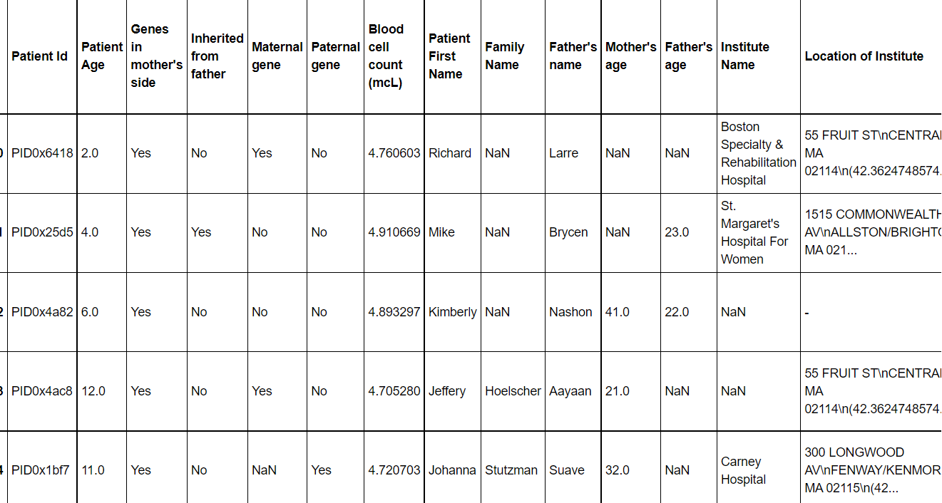
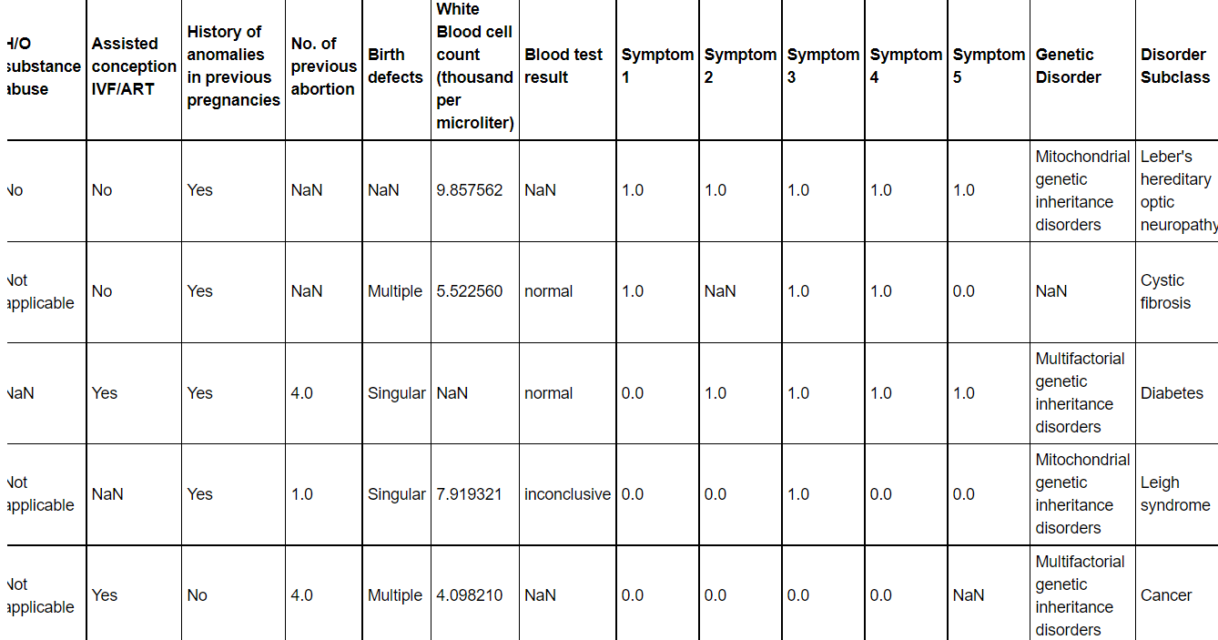
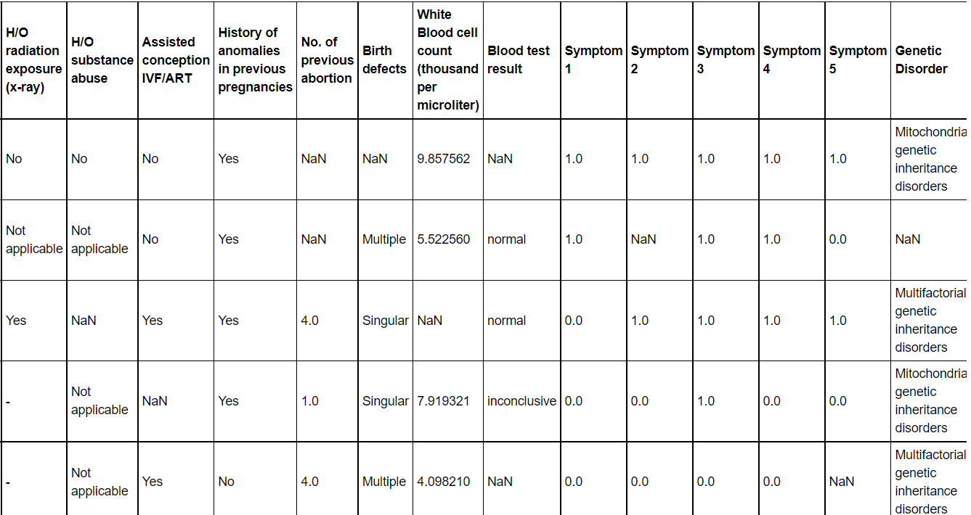
Supportive Documents
Dataset (train)

